Slide 1




PiWIN
Radio Link Failure Prediction Project
Phase IV

Slide 2

Summary:
The team
Introduction
Issues
Competition
Solution
Advertising
Marketing strategy
UI/UX
Conclusion

Slide 3

The Team:
Khalil Allah Abbes
Bilel Mensi
Maroune Guezmir
Eya Amri
Yassine Hamdaoui
Alone we can do so little,
Together we can do so much
-Hellen keller

Slide 4
Introduction
Nowadays 5G is a big subject in technology field in fact our team is proposing the greatest solution for the biggest problem which is Radio Link failure

Slide 5
Issues
Radio Link Failure is a challenging problem in 5G networks as it may decrease communication reliability and increases latency. This is against the objectives of 5G, particularly for the ultra-Reliable Low Latency Communications

Slide 6
Competition
Most companies offer artificial intelligence algorithms that help telephone operators increase their sales with recommendation systems and digital marketing techniques without offering tools to improve network quality.

Slide 7






Competitors
Competitors

Slide 8


Performance
Positioning card
Price

Slide 9
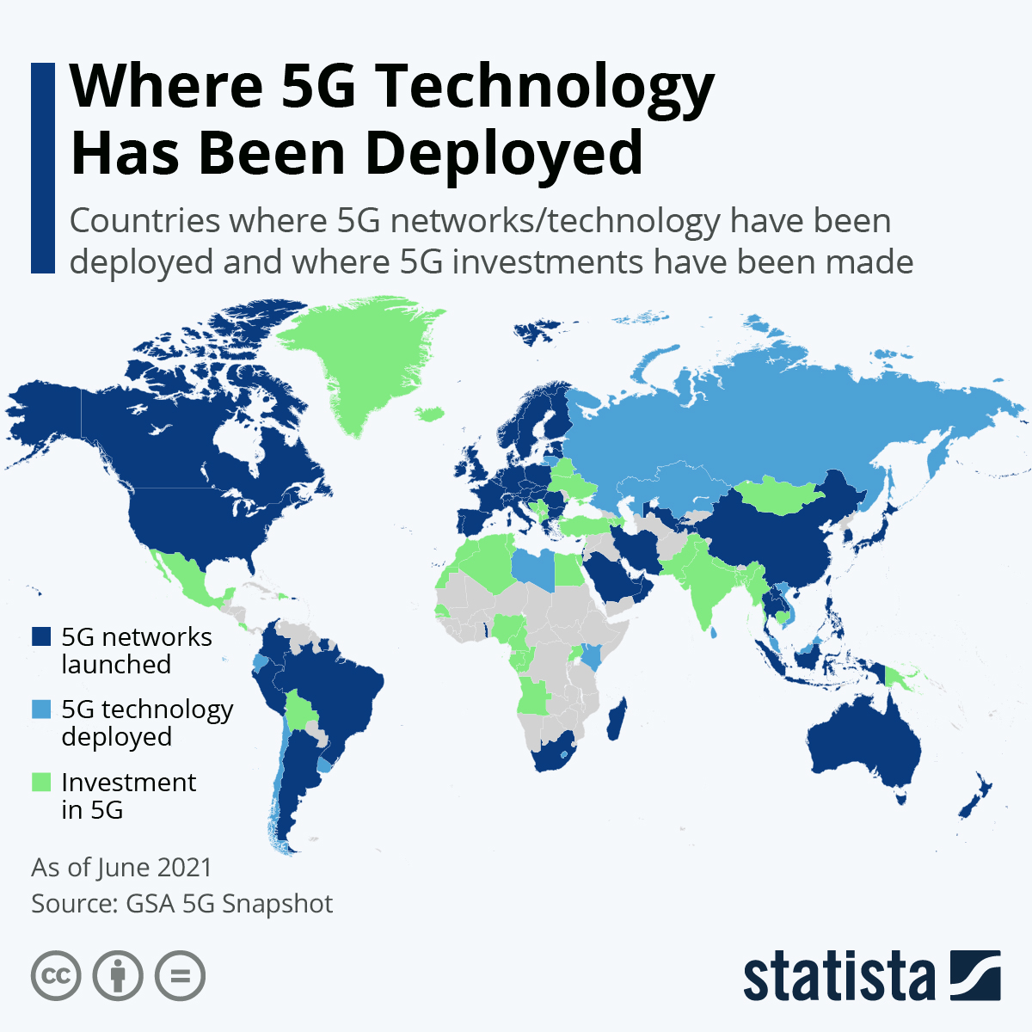
5G in the world

Slide 10
Solution
We offer an algorithm that predict radio link failure for next day and next 5 days based on region, historical data and weather data.
We offer the possibility to identify the causes of the radio link failure
Our solution allows you to identify weather conditions that affect directly the network
With us you can nticipate the settings to be made on the radio stations to avoid radio link failure

Slide 11
What?
Who?
Phone Operators
Why?
To guarantee a network without RLF
A Dashboard and an algorithm to predict RLF

Slide 12
Promises
A network without radio link failure
High performance
Customizable and scalable solution
Maintenance and after-sales service

Slide 13
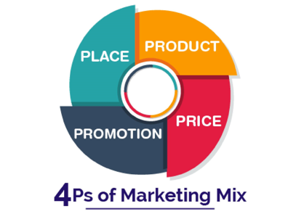
Marketing strategy
Our marketing strategy is based on 4Ps mix

Slide 14
Marketing strategy
Product
An API and a dashboard who offer radio link failure for operators
Promotion
target international events and organize business trips
doing a advertising campaign on social networks like LinkedIn, YouTube, Instagram
sending out brochures by email to different companies
Price
offers the customer a complete quality guaranteed package at a very reasonable price
Place
All over the world

Slide 15
Dashboard

Slide 16
Dashboard

Slide 17

Conclusion
As a conclusion we can say that our team is providing a creative and effective way to solve Radio Link Failure and give the client the best service in this revolutionary technlogy ,the 5G .

Slide 18


